Slide 1
Object Oriented

Slide 2
class Product
{
public double price;
public int stock;
}

Slide 3
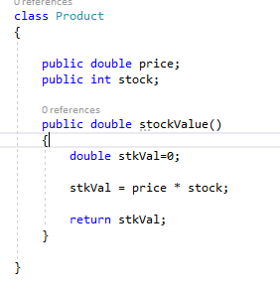

Slide 4
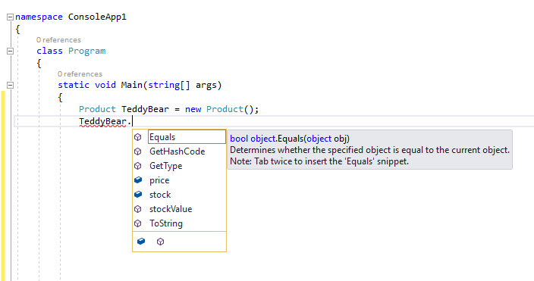

Slide 5
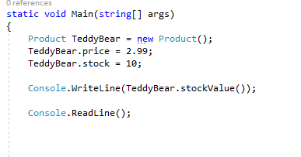

Slide 6
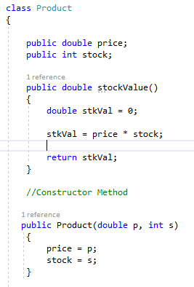

Slide 7
